Slide 1
Pytorch_EHR: Enabling building Recurrent Neural Network based Predictive Models using Electronic Health Records
A Hands-On Tutorial
Brought you by Degui Zhi, Laila Rasmy, Ziqian Xie
ACM-BCB 2022

Slide 2
Learning Objectives
Understanding the theories behind EHR predictive modeling using deep learning.
Learn the basic tools of deep learning to convert theory to practice.
Understand the basics of proper cohort definition.
Practice data preparation and preprocessing
Practice RNN model training and evaluation for binary classification and survival prediction
Learn different techniques used for hyperparameter tuning.
Learn how to present model predictions as well as explanations using attribution mechanism.

Slide 3
Agenda
Introduction of the EHR predictive modeling: theory and practice
EHR data preparation
RNN-based model training and evaluation
Explainability of model predictions

Slide 4

Section 1: EHR predictive modeling: Introduction and theory
Degui Zhi, (Twitter @zhizhid)
School of Biomedical informatics,
University of Texas Health Science Center at Houston

Slide 5
Learning Objectives
Understanding the theories behind EHR predictive modeling using deep learning.
Learn the basic tools of deep learning to convert theory to practice.
Understand the basics of proper cohort definition.
Practice data preparation and preprocessing
Practice RNN model training and evaluation for binary classification and survival prediction
Learn different techniques used for hyperparameter tuning.
Learn how to present model predictions as well as explanations using attribution mechanism.

Slide 6
Introduction: Deep learning for EHR predictive modeling

Slide 7
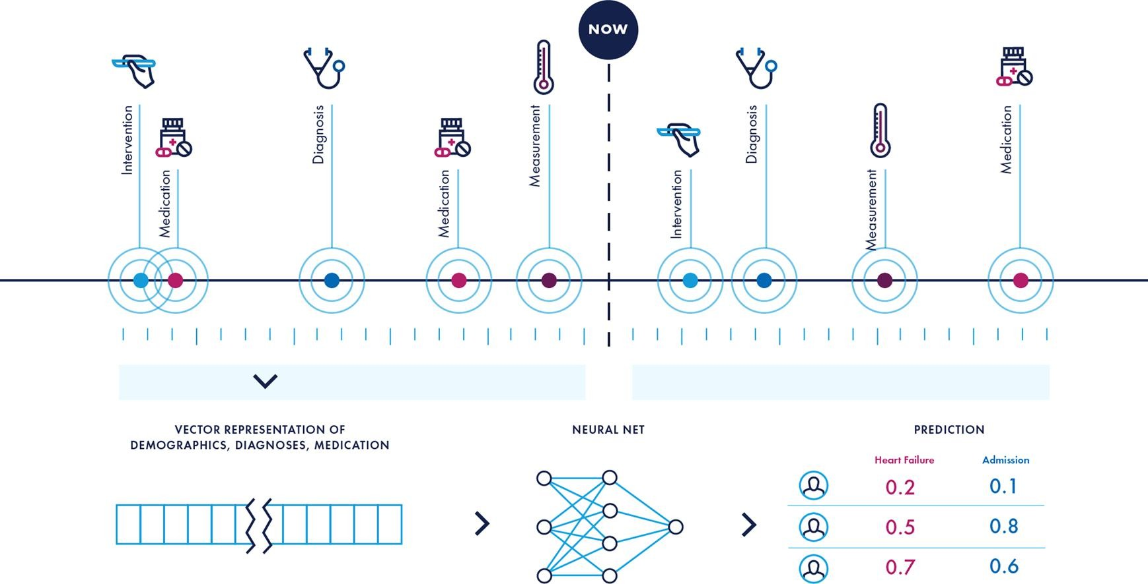
Deep Learning for EHR Predictive Modeling
Solaris et al, J Biomed Informatics, 2020

Slide 8
Why Deep Learning?
Flexible architecture of neural nets allows modeling complex dependency structures in EHR data.
Data Volume
Data Quality
Temporality
Multi-Modality
Knowledge
https://academic.oup.com/bib/article/19/6/1236/3800524

Slide 9
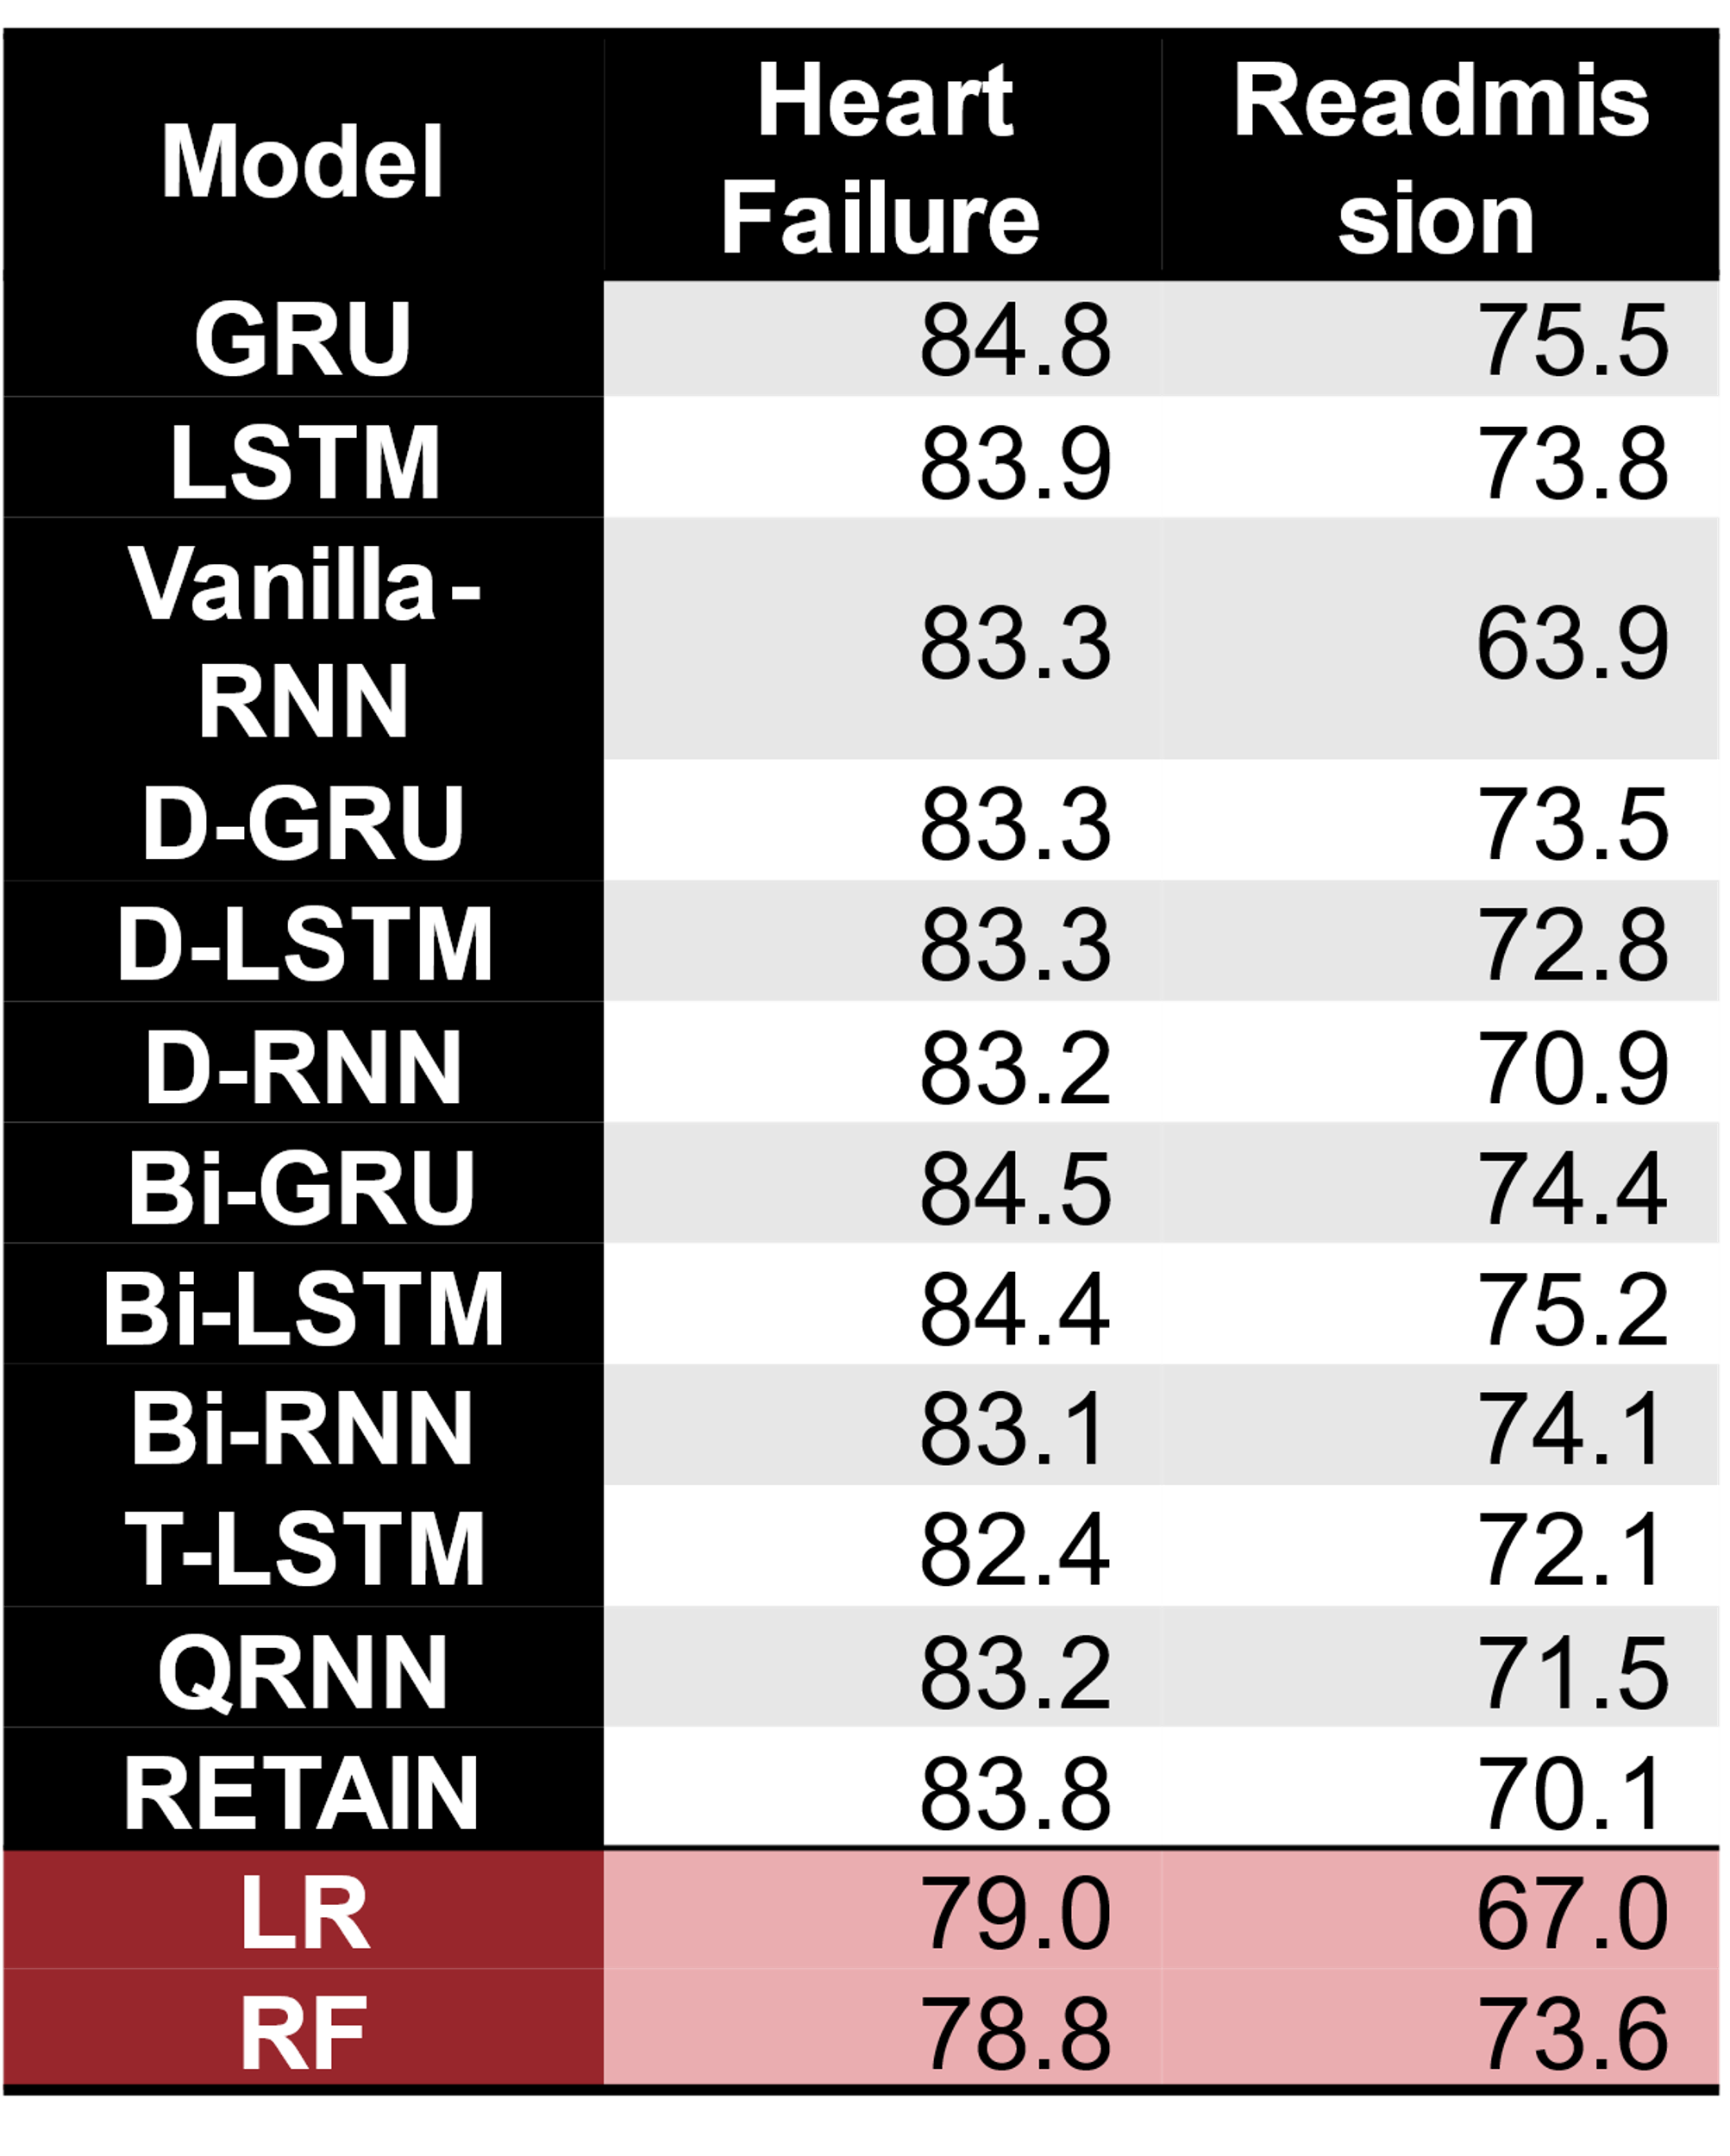
Deep Learning starting to achieve SotA
Rasmy et al, MedInfo, 2018
https://arxiv.org/abs/2110.00998
9

Slide 10
Pooling data improves performance
RNN-based RETAIN model
Predicting Heart Failure Risks for 10 largest hospitals in Cerner Health Facts 2016
Each hospital has 2,000-6,500 patients
Full data set has 1.3 million patients
Rasmy et al, J Biomedical Informatics, 2018
10

Slide 11
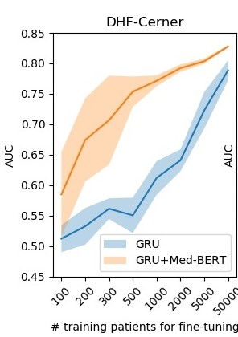
Pre-trained models boost performance
Untrained Med-BERT
Pre-training
28 million patients EHR
Performance boost
Trained Med-BERT
Predictive model
Un-trained Med-BERT
Predictive model
Trained Med-BERT
2000 patients
Fine-tuning
2000 patients
Predictive model
Un-trained Med-BERT
Predictive model
Trained Med-BERT
Rasmy et al, npj Digital Medicine, 2021

Slide 12
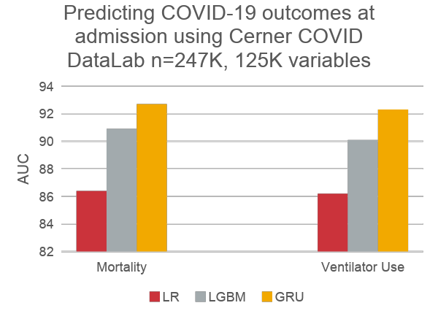
Our most recent example
2022 ACM-BCB Tutorial
Rasmy et al, Lancet Digital Health, 2022

Slide 13
Why Deep Learning?
Flexible architecture of neural nets allows modeling complex dependency structures in EHR data.
Data Volume
Data Quality
Temporality
Multi-Modality
Knowledge
https://academic.oup.com/bib/article/19/6/1236/3800524

Slide 14
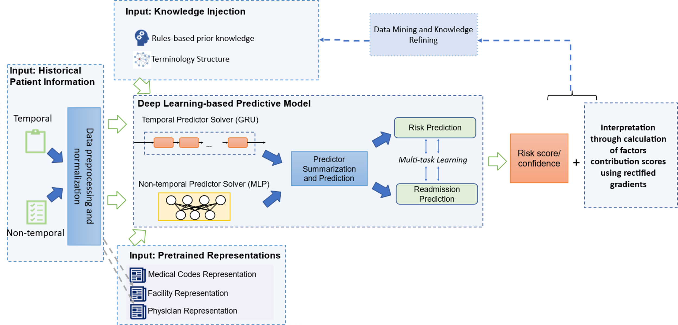
Promise: An integrated DL system
KERM-IT: Knowledge-enriched Explainable Recurrent Multi-task model: an Innovative solution for healthcare Transformation, Rasmy et al. Unpublished 2019
14
Notes:
Place holder

Slide 15
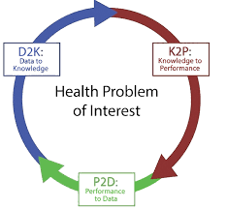
Future: Towards an integrated learning health system
Shared Model
Shared Data
2022 ACM-BCB Tutorial

Slide 16
Theory: RNN for structured EHR

Slide 17
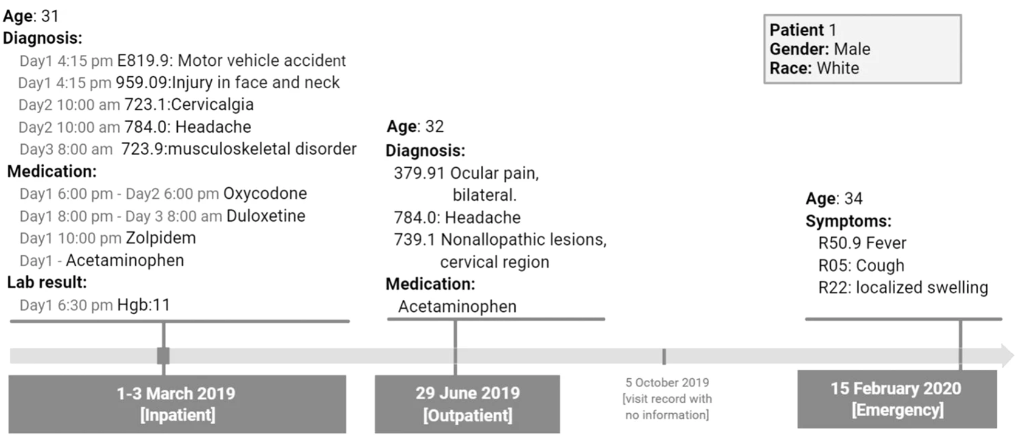
Electronic Health Records (EHR) One of the richest (and messiest) sources of patient information
Rasmy et al, npj Digital Medicine, 2021

Slide 18
EHR data vs NLP data
Criteria | Natural language | EHR
Token granularity | word | code
Syntactic: Hierarchical structure | Document – paragraph- sentence – phrase - word | Patient – visit – code (of different categories)
Syntactic: Sequential order | Simple and clear. | Codes may with time stamp, but the codes within a visit may be unordered
Semantic | Dependency relations are clear to average human. | Dependency unclear
Time interval | Regular | irregular
Data completeness | Relatively complete. | Usually incomplete, may contain errors.
Sequence length | Within a relatively narrow range. | More variable
Rasmy et al, npj Digital Medicine, 2021
Notes:
Split Hierarcliar for granulaity

Slide 19
EHR predictive modeling: Input data modality
Episodic
Continuous monitoring
Longer time span, chronical conditions
Patient is a sequence of visits
Time interval irregular between visits
Each visit has a number of codes
Each codes are categorical variable
Shorter time span, acute intense care, usually a single visit
Patient has observations at continuous times
One measure per variable per window

Slide 20
EHR predictive modeling: Output data modalities
Binary outcomes
Survival (Binary outcome with a time horizon)
Continuous variables (e.g., biomarkers)
Drug concentration monitoring
Multiple structured outcomes (e.g., length of stay)

Slide 21
Two flavors of EHR modeling
Episodic
Continuous monitoring
Longer time span, chronical conditions
Patient is a sequence of visits
Time interval irregular between visits
Each visit has a number of codes
Each codes are categorical variable
Shorter time span, acute intense care, usually a single visit
Patient has observations at continuous times
One measure per variable per window
https://www.youtube.com/watch?v=co3lTOSgFlA&feature=youtu.be
(Choi et al, JAMIA, 2017)

Slide 22

Recurrent Neural Network - RNN
An unrolled recurrent neural network.
https://www.youtube.com/watch?v=co3lTOSgFlA&feature=youtu.be
http://colah.github.io/posts/2015-08-Understanding-LSTMs/

Slide 23
The RNN Framework
Output Ŷ
Project the patient’s health status to some predictive outcome at a time step
Prediction head
Updated vector representation of patient’s health status at a time step
RNN
Hidden vector representation of the new input at a time step
Embedding
Input X
Preprocessed EHR data at a time step

Slide 24
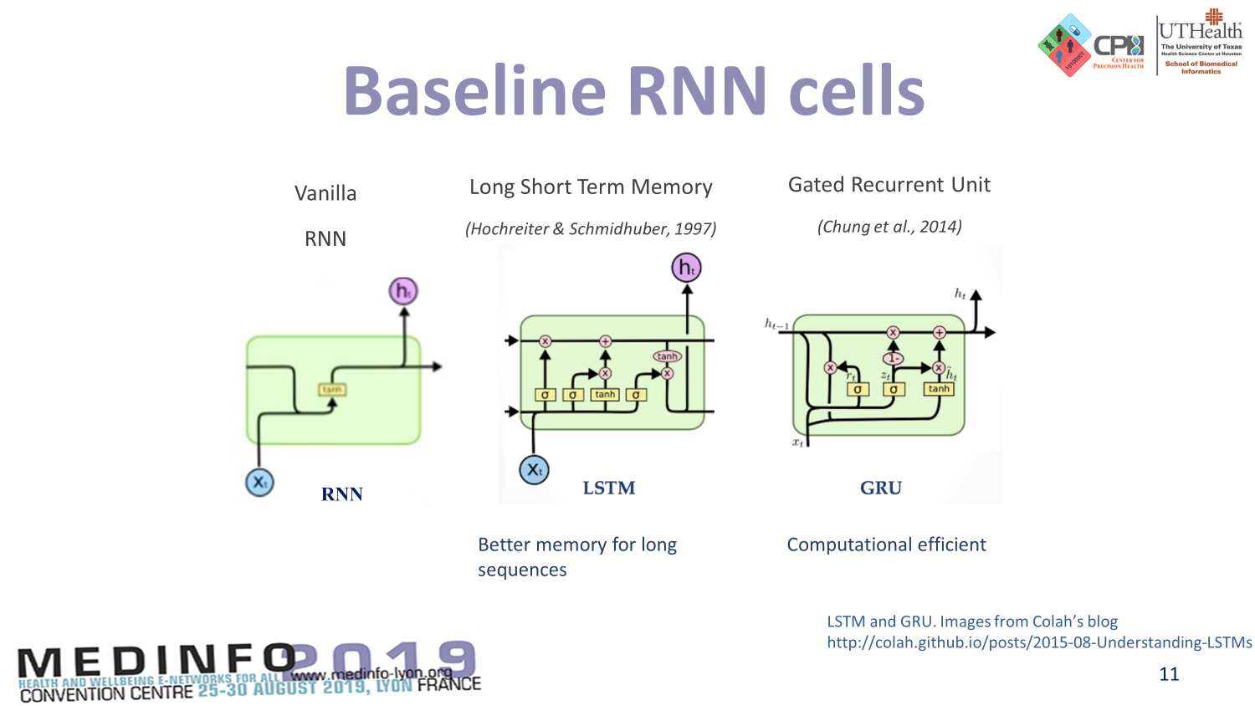



Baseline RNN cells
LSTM and GRU. Images from Colah’s blog
http://colah.github.io/posts/2015-08-Understanding-LSTMs

Slide 25
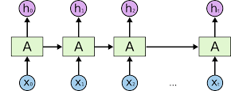
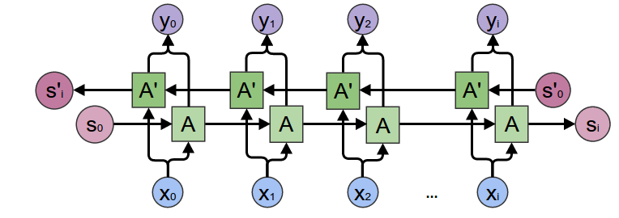
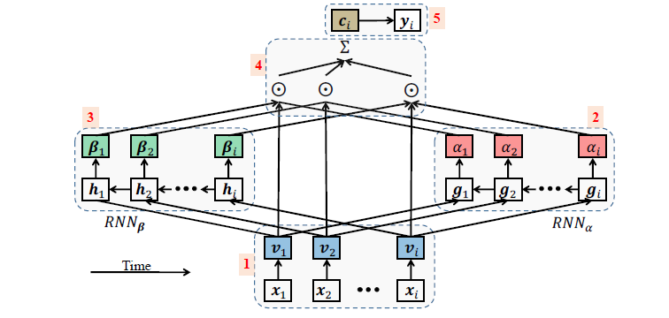
more RNN structures
Basic Unidirectional RNN
RETAIN model architecture
(Choi et al., 2016)
Bidirectional RNN
(Schuster & Paliwal, 1997)
Better representation of the context and eliminate ambiguity.

Slide 26
Hyperparameter tuning
Gether Data
Prepare Data
Modeling
Training
Evaluation
Hyperparameter tuning

Slide 27
Practice: Software packages for EHR predictive modeling

Slide 28
Major components of EHR predictive modeling
Data Preparation
Prediction Engine
Interpretation

Slide 29
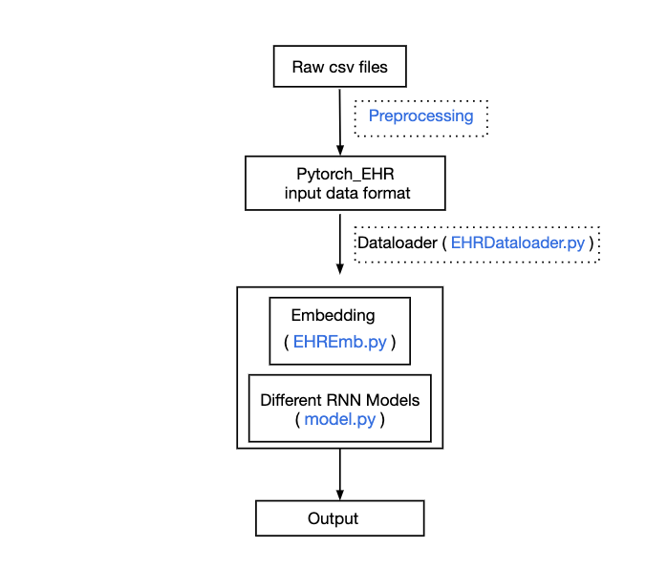
PyTorch_EHR: source codes based on PyTorch to analyze EHR
Lower the bar of entering this field for researchers
Provide efficient data loading
Enable experimenting mix and match of components
Deliver competitive performance
https://github.com/ZhiGroup/pytorch_ehr

Slide 30
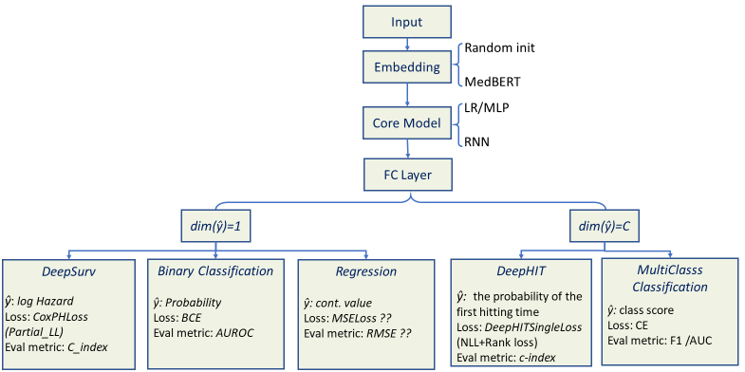
Pytorch_EHR (v.3) Framework
Raw Data Extraction
Terminology Normalization
Preprocessing
Prediction Module
Explainability Module
Multi-metric
Evaluation Module
30

Slide 31
Section 2: Data Preparation
Laila Rasmy,
School of Biomedical informatics,
University of Texas Health Science Center at Houston

Slide 32
Learning Objectives
Understanding the theories behind EHR predictive modeling using deep learning.
Learn the basic tools of deep learning to convert theory to practice.
Understand the basics of proper cohort definition.
Practice data preparation and preprocessing
Practice RNN model training and evaluation for binary classification and survival prediction
Learn different techniques used for hyperparameter tuning.
Learn how to present model predictions as well as explanations using attribution mechanism.

Slide 33
Cohort Definition
Steps toward proper cohort definition:
Understand the clinical problem
Engage stakeholders (clinicians / users)
Clearly define your outcome based on how the model is intended to be used
What to predict
When to predict
Understand the data
strength
Limitations
Decide on your inclusion / exclusion criteria
Basic data cleaning
Our model can consume all data, so no need for further feature selection
33

Slide 34
Let's Practice Now
https://github.com/ZhiGroup/pytorch_ehr/tree/ACM-BCB
Cohort definition and data extraction from the EHR database
Data reformatting to be efficiently consumed by Pytorch_ehr

Slide 35
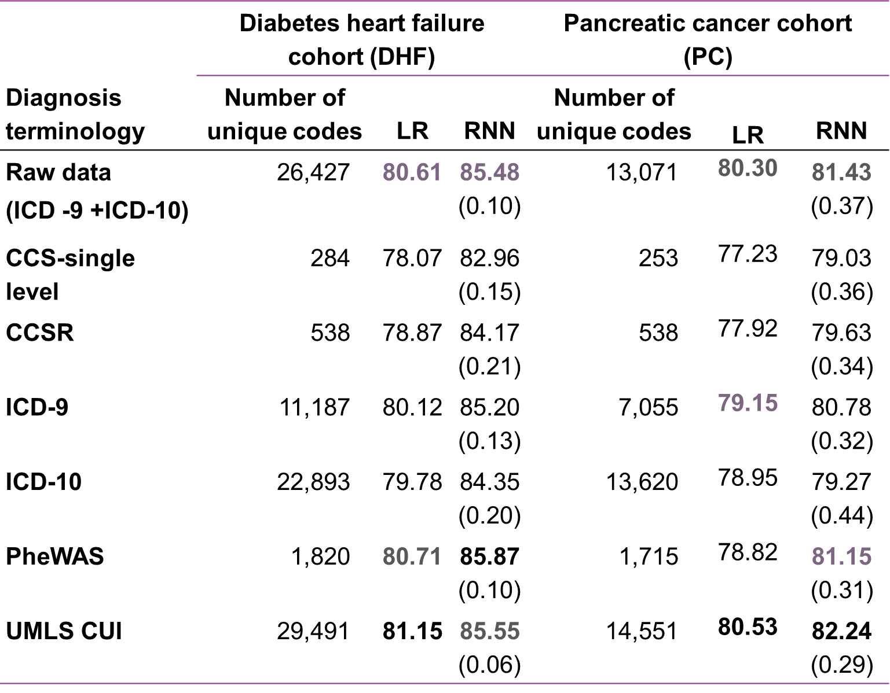
Terminology Normalization
https://github.com/ZhiGroup/terminology_representation

Slide 36
Section 3 : Model Training & Evaluation
Laila Rasmy,
School of Biomedical informatics,
University of Texas Health Science Center at Houston

Slide 37
Learning Objectives
Understanding the theories behind EHR predictive modeling using deep learning.
Learn the basic tools of deep learning to convert theory to practice.
Understand the basics of proper cohort definition.
Practice data preparation and preprocessing
Practice RNN model training and evaluation for binary classification and survival prediction
Learn different techniques used for hyperparameter tuning.
Learn how to present model predictions as well as explanations using attribution mechanism.

Slide 38
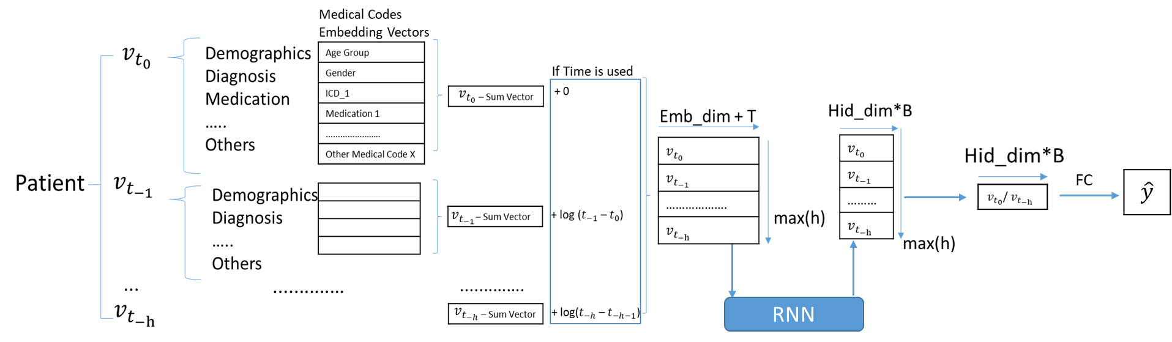
Pytorch_EHR: under the hood

Slide 39


Packed Sequence
4
4
3
2
$$\hat{y}$$
$$t_{o} t_{1} t_{2} t_{3}$$
pack_padded_sequence
pad_packed_sequence

Slide 40
Let's Practice Now
Model training for binary classification
Model training survival prediction
Hyperparameter tuning
Model evaluation
Back to the colab

Slide 41
Section 4: Explanation by Attribution score lens into the inner working of the models
Ziqian Xie, Ph.D.

Slide 42
Learning Objectives
Understanding the theories behind EHR predictive modeling using deep learning.
Learn the basic tools of deep learning to convert theory to practice.
Understand the basics of proper cohort definition.
Practice data preparation and preprocessing
Practice RNN model training and evaluation for binary classification and survival prediction
Learn different techniques used for hyperparameter tuning.
Learn how to present model predictions as well as explanations using attribution mechanism.

Slide 43
Explainable Pytorch_EHR
Attribution module
Explanations

Slide 44
Attribution mechanism
Assign a value to each of the input features
The value represent the contribution of the feature to the output of the model
Common methods includes LIME [1], SHAP [2], LRP [3], IG [4], etc.
[1] Ribeiro, Marco Tulio, Sameer Singh, and Carlos Guestrin. "" Why should i trust you?" Explaining the predictions of any classifier." Proceedings of the 22nd ACM SIGKDD international conference on knowledge discovery and data mining. 2016.
[2] Lundberg, Scott M., and Su-In Lee. "A unified approach to interpreting model predictions." Proceedings of the 31st international conference on neural information processing systems. 2017.
[3] Montavon, Grégoire, et al. "Layer-wise relevance propagation: an overview." Explainable AI: interpreting, explaining and visualizing deep learning (2019): 193-209.
[4] Sundararajan, Mukund, Ankur Taly, and Qiqi Yan. "Axiomatic attribution for deep networks." International Conference on Machine Learning. PMLR, 2017.

Slide 45
Integrated Gradient
Posthoc method
Computation doesn’t require modifying network structure
Has some good theoretical properties

Slide 46
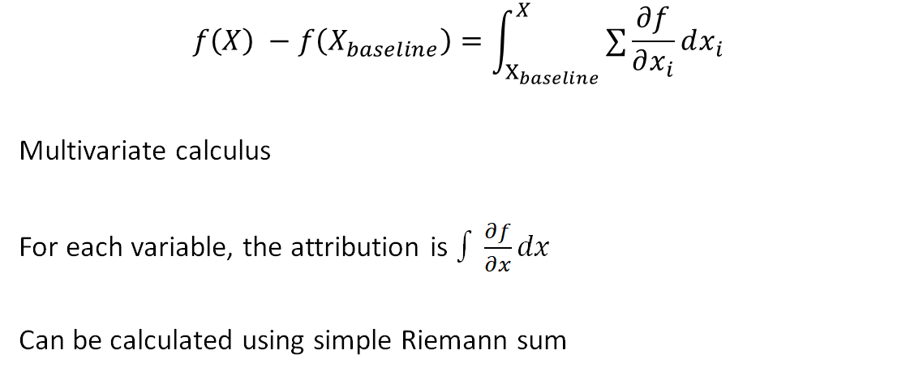
Integrated Gradient

Slide 47
Pytorch implementation
Make sure the feature tensor that you want to calculate attribute score on is a leaf node (detach if necessary)
Set requires_grad = True
Gradually increase the feature from baseline level to current level, accumulate the gradient.

Slide 48
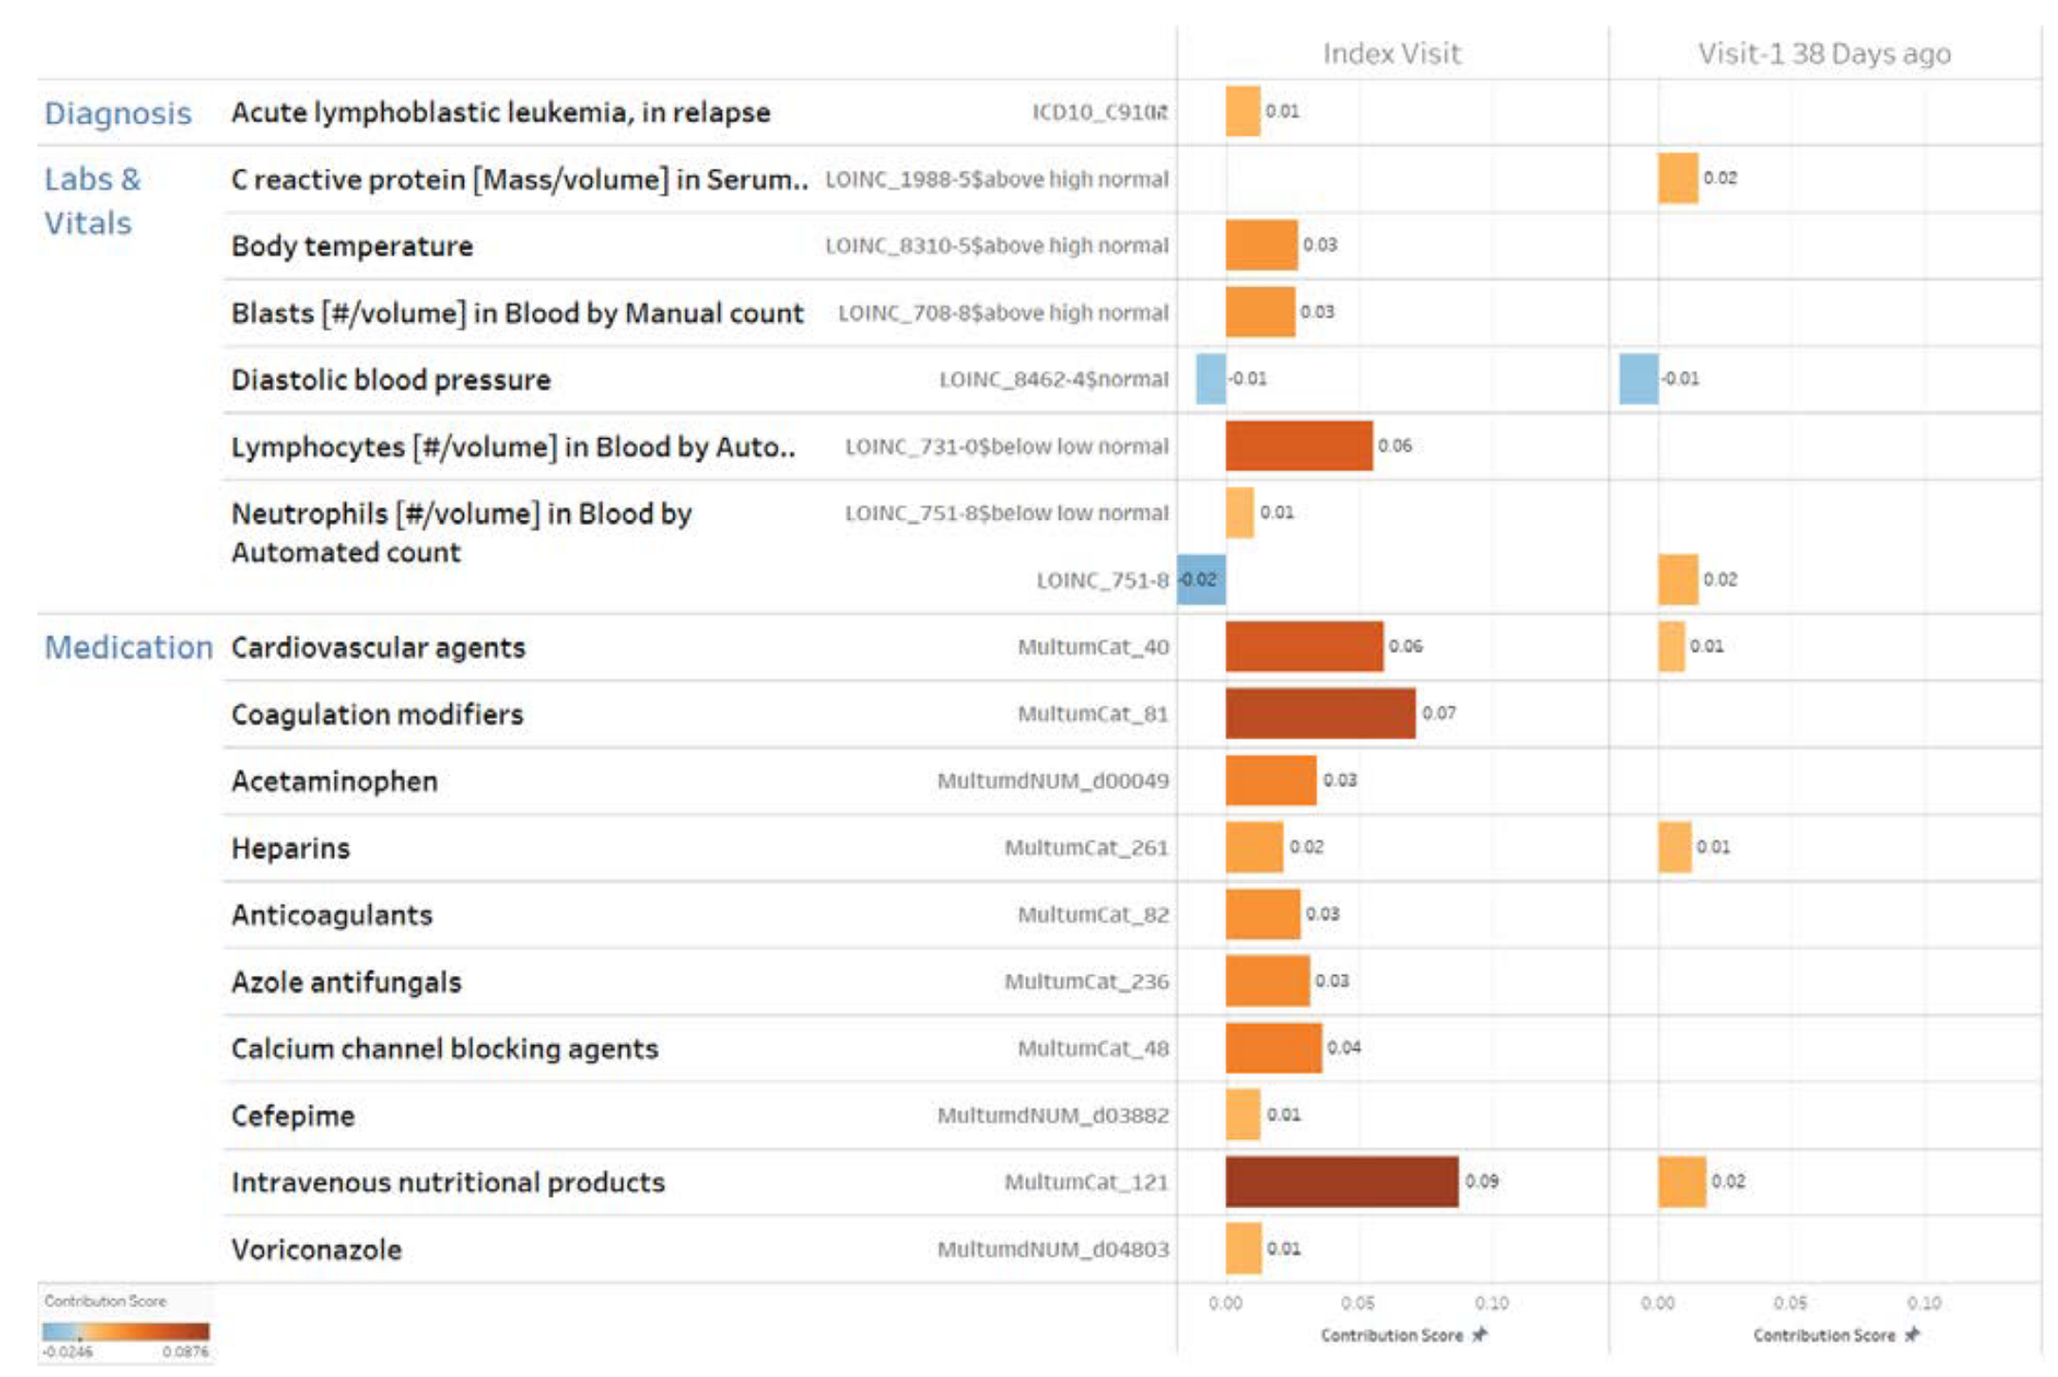
Example

Slide 49
Let's Practice Now
Back to the colab
49

Slide 50
Thank you!
https://github.com/ZhiGroup/pytorch_ehr/

Slide 51
Pytorch_EHR v.3 Framework
Raw Data Extraction
Terminology Normalization
Preprocessing
Predictive Model
Explainability Module
Multi-metric
Evaluation Module

